Slide 1
Racial Housing Discrimination and Home Values*
An analysis by Ben Warren
*In Carlisle, PA

Slide 2
Introduction to racial covenants
Research questions
Data sources
Exploratory analysis
Modeling
Conclusions

Slide 3
Throughout the 20th century, white people across the U.S. used racial covenants to restrict who could live in their neighborhoods…
- Racial deed restriction on Rolling Acres development, Carlisle, PA (1948)

Slide 4
They often justified these racist policies by saying they kept property values high
“A Realtor should never be instrumental in introducing into a neighborhood a character of property or occupancy, members of any race or nationality, or any individuals whose presence will clearly be detrimental to property values in that neighborhood.”
- National Association of Real Estate Boards Code of Ethics (1924)

Slide 5
Research Questions

Slide 6
Are properties with racial covenants worth more today?
Are Black-owned homes (c. 1900) worth less today?
Property developments “protected” by racial covenants were worth more to white buyers in the early- and mid-20th century.
Lending discrimination, disinvestment, and racial inequality in the workforce are all possible negative factors on the value of Black-owned homes.

Slide 7
Cumberland County property mapper
Large data set of Cumberland Co. properties, including home characteristics, property values, and recent sale prices.
Racial covenants data set
Data Sources
Incomplete data set of racial property restrictions in Carlisle area, compiled from county archives and Recorder of Deeds office
1900 census data
Address-level data of ~300 Black households in Carlisle in 1900, from that year’s U.S. decennial census

Slide 8
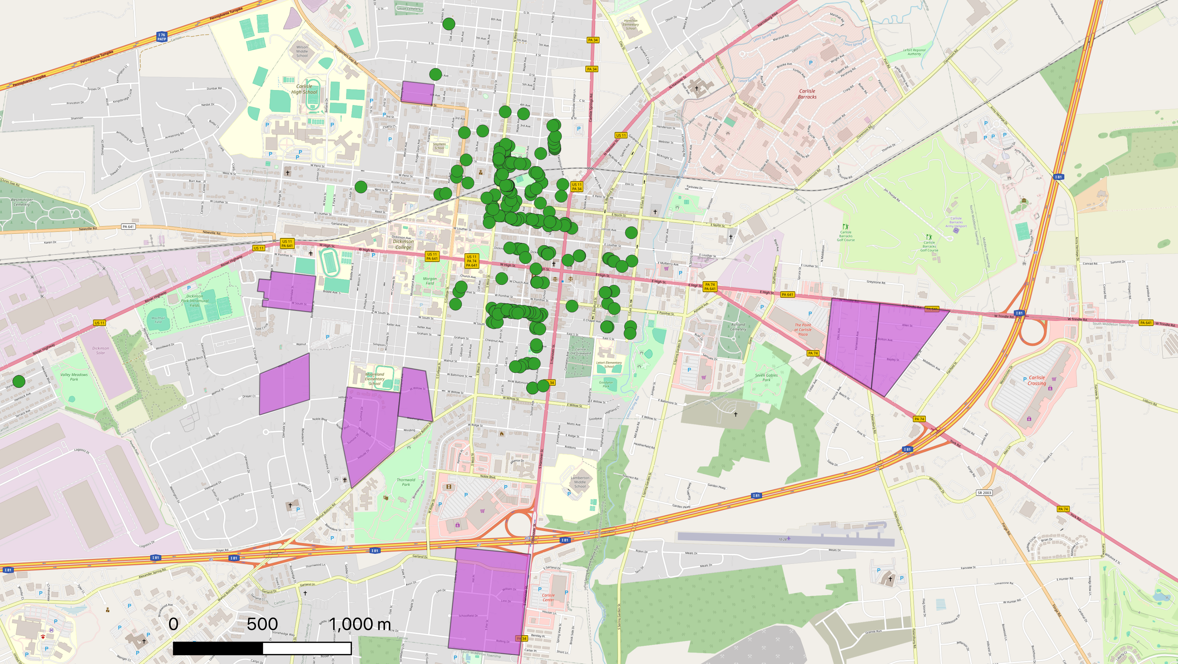
SlidesCarnival
Dark Minimalist
08/12/2024
Restricted development
Black household (1900)

Slide 9
Home values vs. Covenants

Slide 10
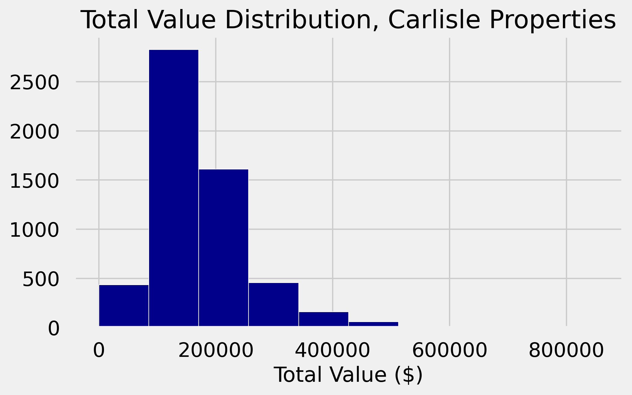
Most properties are worth between $100K-200K

Slide 11
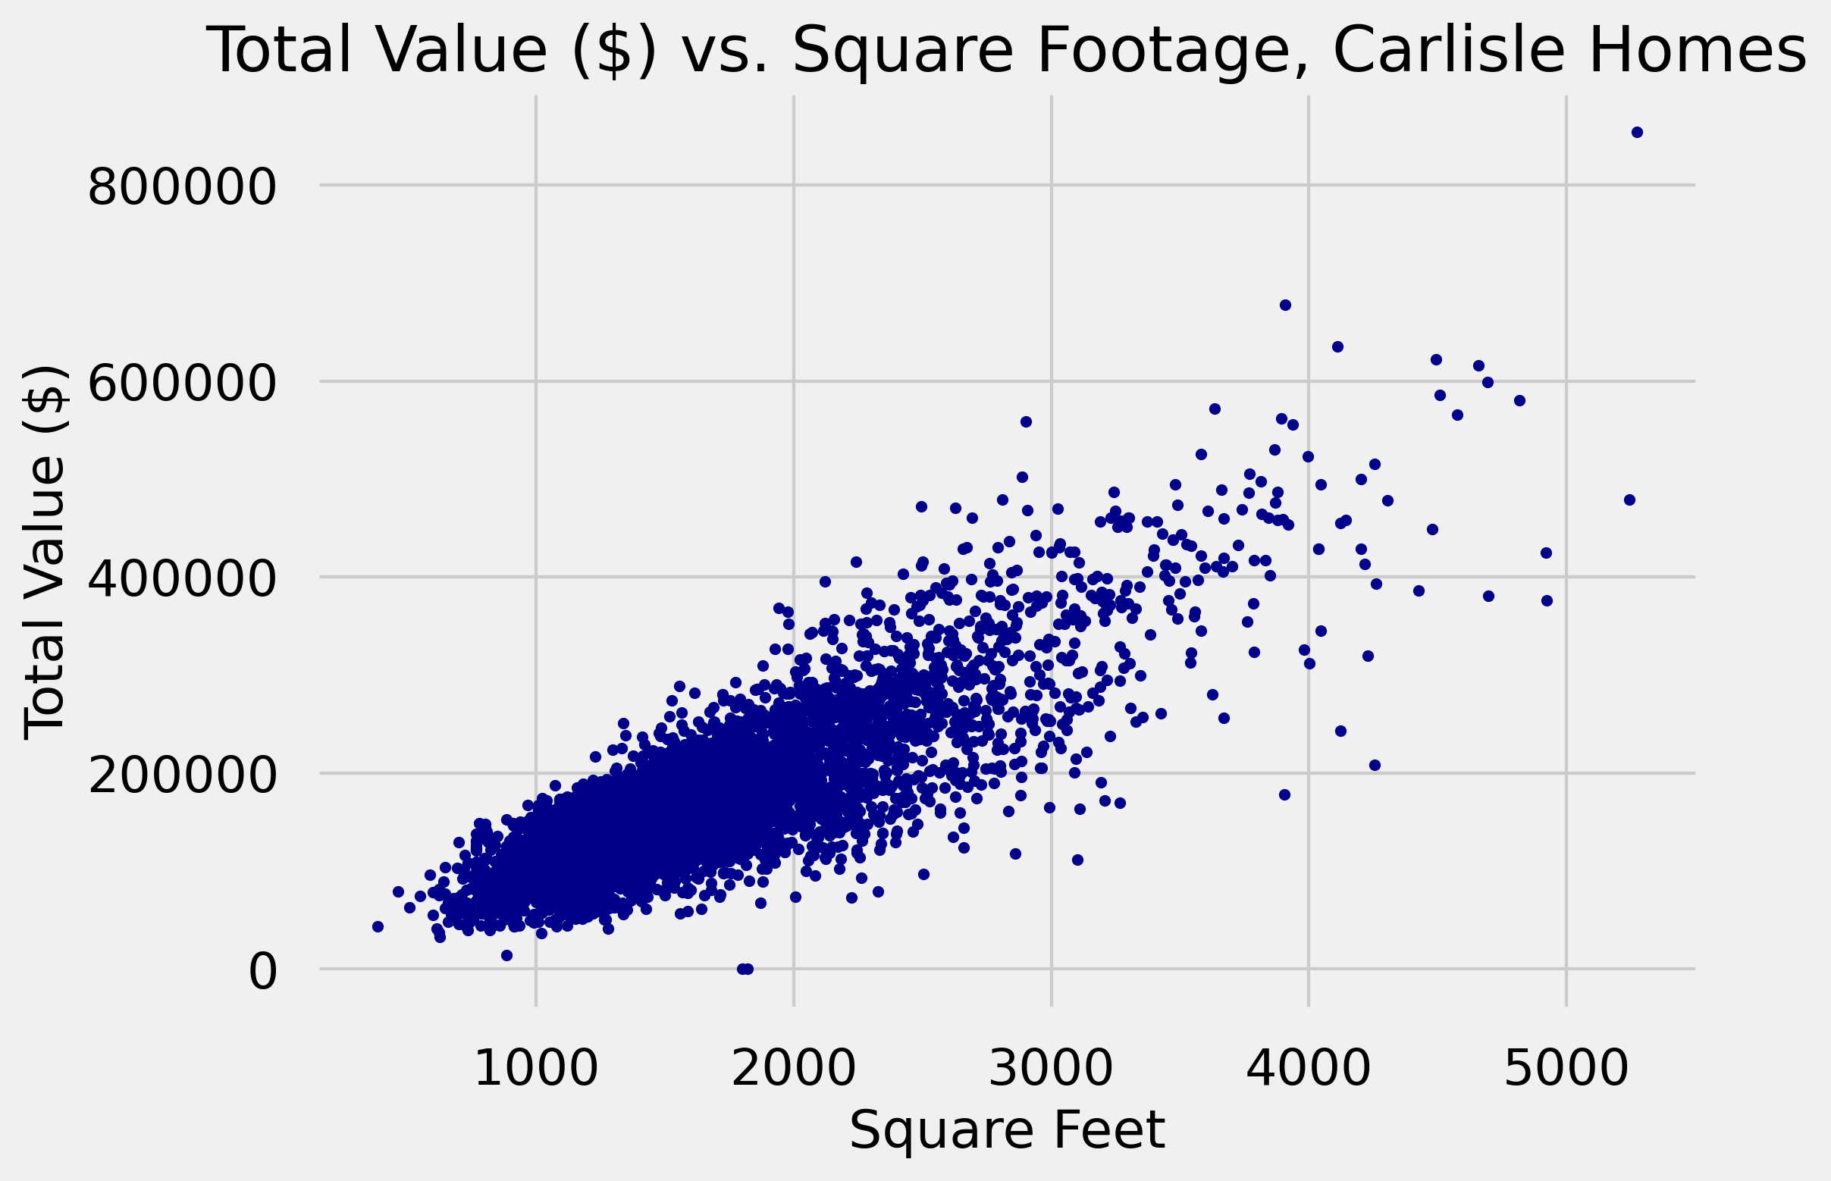
SQFT is strongly correlated with total value ($).

Slide 12
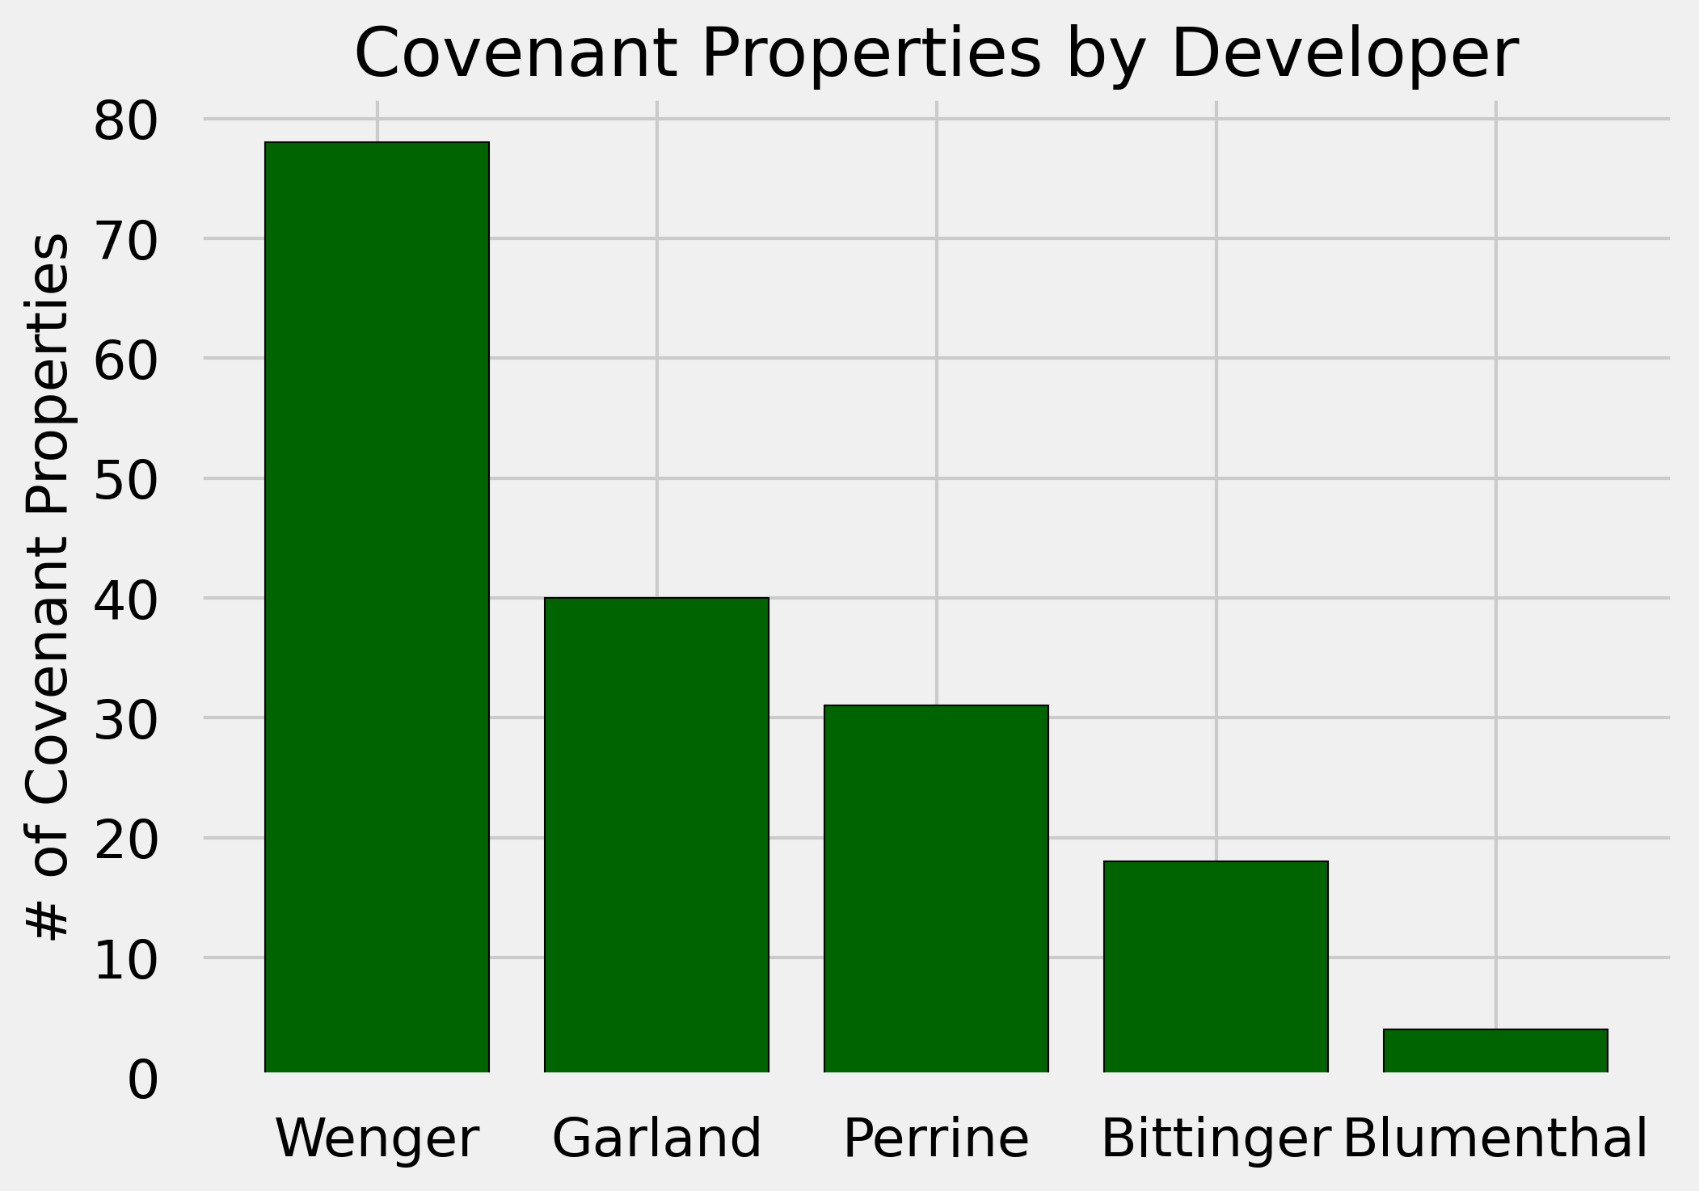
Roy H. Wenger developed the most properties with racial covenants, 78

Slide 13
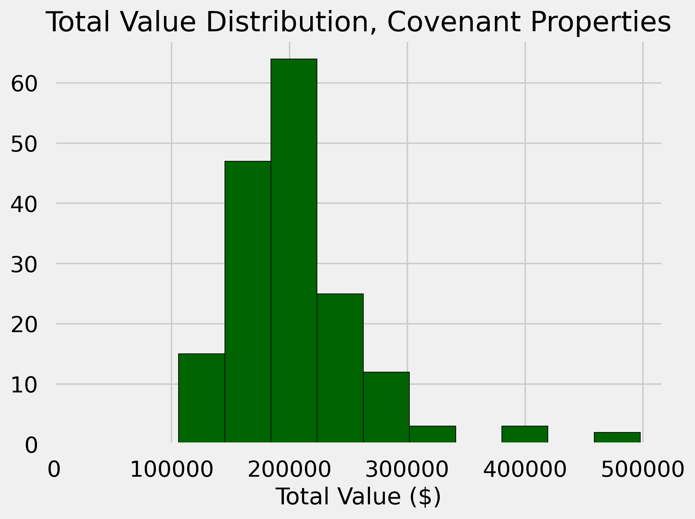
Most properties with covenants are worth around $200K

Slide 14
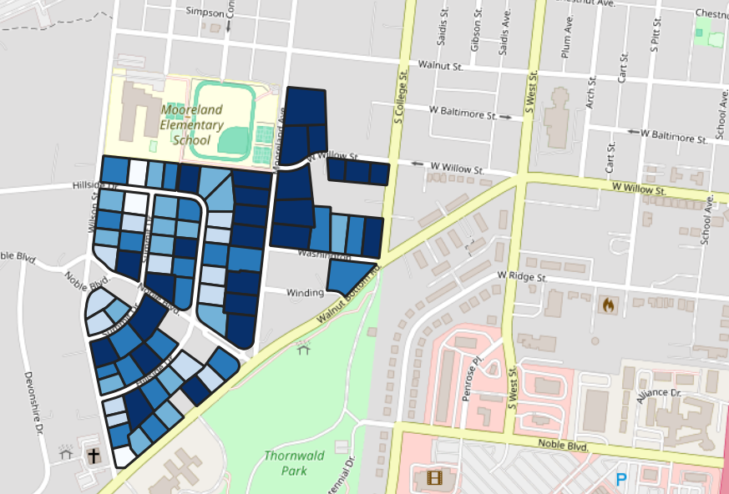
Even within the same development, property values vary greatly
$100K
Total Value ($)
$300K

Slide 15
+23.8%
Modeling
Median total value of restricted properties
Least-squares regression // Random forest regression
0.006*
R² value, OLS regression (total value ~ covenants)
0.074
RFR feature importance of distance to nearest covenant
*p-value < 0.001

Slide 16
Home values vs. Black ownership in 1900

Slide 17
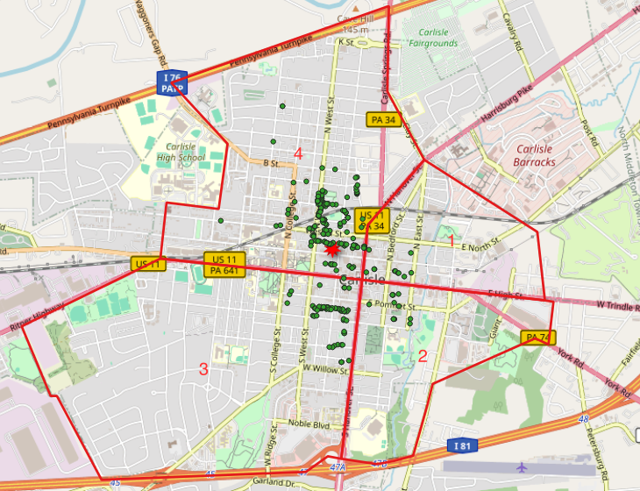
Black household (1900)

Slide 18
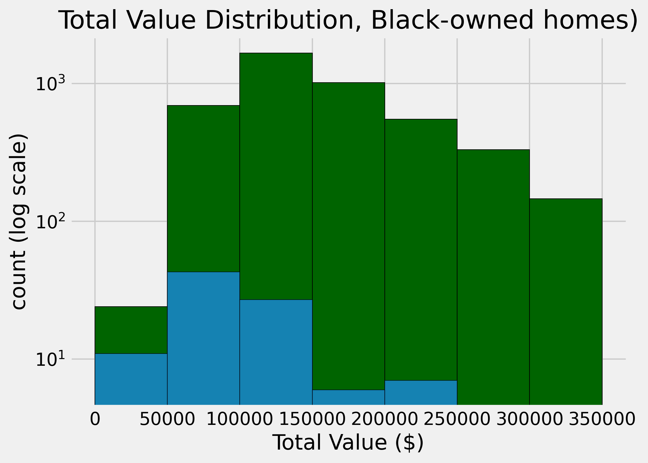
Black-owned (1900)
Other

Slide 19
-34.4%
Modeling
Median total value of Black-owned properties
Least-squares regression // Random forest regression
-$6,350*
Regression coefficient, OLS regression
(total value ~ Black-owned)
0.014
RFR feature importance of distance to nearest Black-owned home
*p-value < 0.001

Slide 20
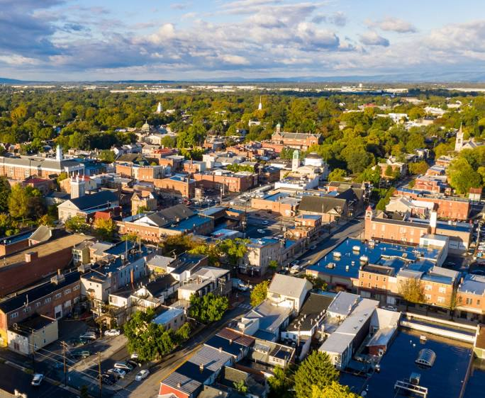
Conclusions
Homes with racial restrictions are worth more on average today
Homes owned by Black households in 1900 are worth less on average today
There is a weak, statistically significant relationship between covenants/Black ownership and home values.

Slide 21

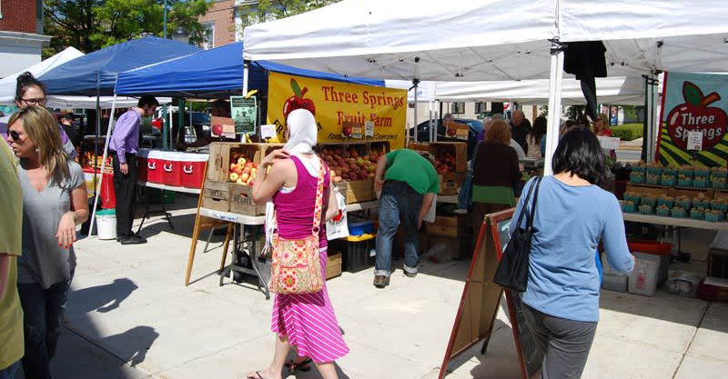
Implications
Despite complicated historical patterns of property values, racial restrictions had a lasting effect
The impacts of this are felt in the persistent Black-white wealth gap across the U.S.
Analyses like these help inform public policy to address housing reform and reparations.

